Slide 1

Authorization
Notes:
Risk-based conditional access
NIST https://auth0.com/blog/what-the-new-nist-guidelines-mean-for-authentication/
Who are you?

Slide 2
Outline
Role-based Access Control (RBAC)
Attribute-based Access Control (ABAC)

Slide 3
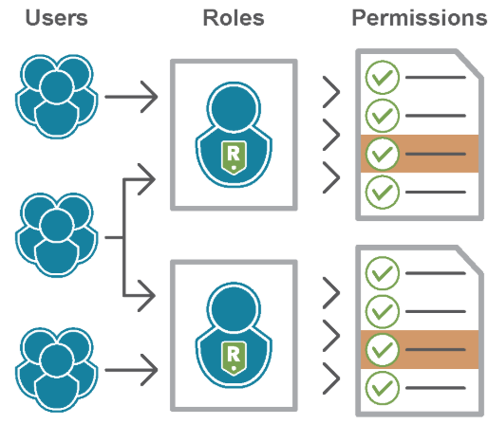
Role-based Access Control (RBAC)

Slide 4
Authorization
Authorization follows authentication
After establishing who the user is, the system needs to decide what they can do
Authorization is usually represented as a policy specification of what resources can be accessed by a given subject (i.e., Who can access what?)
Can also include the nature of the access (e.g., read, write)
Subject or Principal | Users of a system could a person or an automated agent
Resource or Object | Resource acted upon by subjects
Notes:
Access control asserts who can access which resource with what capability under what condition
Privilege Authorization to access a certain resource or do a certain action.
Role A defined set of Privileges.
User A person or automated agent.
Group A defined set of Users.
Policy specifying how entities can interact with resources
i.e., Who can access what?
Requires authentication and authorization
Discretionary Access Control (DAC)
Owners of objects specify policy
Mandatory Access Control (MAC)
Policy based on sensitivity levels – e.g., clearance
Owners do not specify their own policies
Role-based Access Control (RBAC)
Central authority defines policy in terms of roles
Roles ≈ permission sets

Slide 5
RBAC vs. MAC/DAC
Mandatory Access Control (MAC) and Discretionary Access Control (DAC)
Users, Groups have Permissions on objects (e.g., files)
DAC allows the owner of the object to determine who has access. In MAC however the access rights are determined by the administrator/policy
Role-based Access Control (RBAC)
Roles have Permissions
Users have Roles
Many-to-many relations
Simplifies maintainability in systems with lots of users
Difference between groups and roles?
Groups: collection of users
Roles:
collection of permissions and possibly other roles
job function within an organization
Notes:
Objects == Rights == Permissions
Particular collection of users and permissions brought together by a role is transitory. The role is more stable because it reflects organizations functions and activities that change less frequently [SCFY96]. One force behind RBAC model is examination of current organizations → need to formalize relationships between users and permissions. Another force – standardization (NIST); no standard products on the market.
Access control was implemented by many systems, but we need the same mechanism for applications.
Example: helpdesk/operators may add/remove users to roles, but should not be able to define new roles
Many-to-many: scalability issues
Difference between groups and roles: UNIX example – determining file permissions
and/or users,

Slide 6
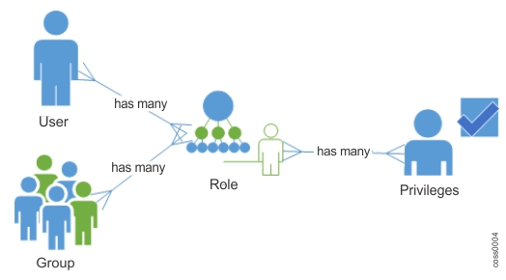
Basic RBAC Illustrated
User Assignment (UA)
Permission Assignment (PA)
Notes:
Privileges can be assigned to multiple Roles.
A User can have multiple Roles.
A Group can have multiple Roles.
A role can be assigned to multiple Users or Groups.
Users can be in multiple Groups.

Slide 7
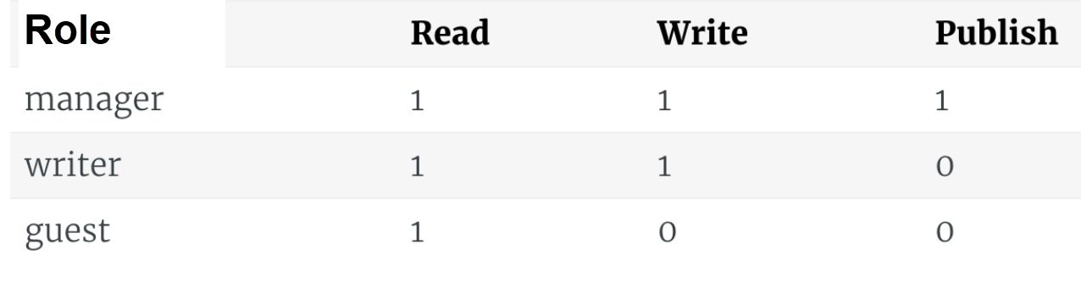
Access Matrix Representation
Role has permissions on resources
e.g., permission on blog posts
Users are assigned to roles
User | Role
Ali | Writer
Fatma | Manager
Samira | Guest
Notes:
Roles can be object → Role hierarchies (discussed later)
- Similar to DAC ACM

Slide 8
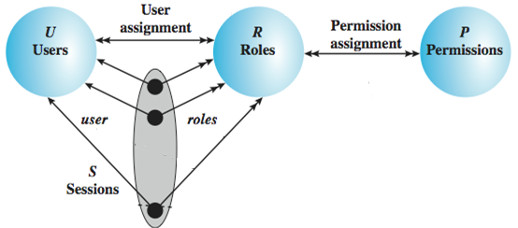
RBAC – Base
Users: individuals with access to the system
Role: named job function within the org
Permission: approval of a particular mode of access to objects
Session: mapping between a user and a subset of roles
Notes:
Session example: UAC in Windows
Session: mapping between a user and a subset of roles
Same as RBAC₀ (users, roles, permissions, sessions)
Object: any resource
Operation: executable image of a program
Permission: approval to perform an operation on object(s)

Slide 9
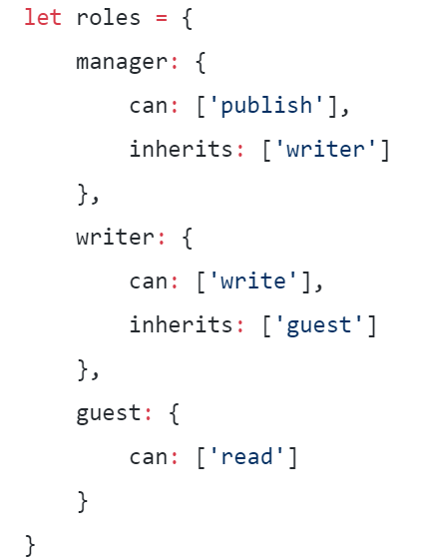
RBAC – Role Hierarchies
Reflect hierarchical structure of roles in org
Guest
Writer
Manager
Manager role has all permissions of Writer role
Writer roles has all permission of Guest role
Notes:
Convention: senior / more powerful roles are on top
Mathematically, partial order (reflexive, transitive, anti-symmetric)
Limiting the scope of inheritance:
Role Hierarchy with private roles

Slide 10
Role Hierarchy Example
Primary-Care Physician
Specialist Physician
ER Nurse
ICU Nurse
Nurse
More specialized (more permissions)
Physician
Health-Care Provider
ICU - Intensive Care Unit
ER - Emergency Room

Slide 11
RBAC – Constraints
Reflect organizational policies
Mutually exclusive roles: no user is allowed to be a member of both roles (e.g., Expenses & Expense Approvals, Hire & Approve Hire)
→ Separation of Duty to prevent conflict of interest
Cardinality – maximum number with respect to role
Prerequisite – can assign role only if already assigned prerequisite role
Notes:
Remember, no hierarchies in RBAC₂
Cardinality constraint on a set of roles
SSD := (role set, n) where no user is assigned to n or more roles from the role set
Mutual exclusive roles as a special case:
SSD := ({r₁, r₂}, 2)
Administrative functions: create/delete role sets, add/delete role members
Review functions: view properties of SSD sets

Slide 12
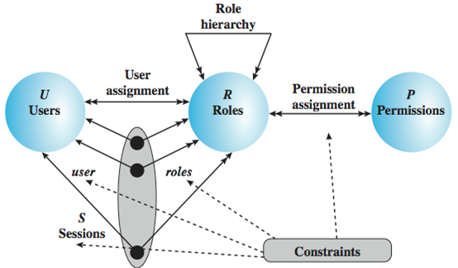
RBAC – Consolidated Model
Notes:
Prerequisites are subsumed by roles hierarchies
Revisit role hierarchy example for mutual exclusion demonstration

Slide 13
Key Points
Roles are collections of permissions, users, and possibly other roles (many-to-many)
Role hierarchies simplify RBAC management and can be derived from org structure
Constraints prevent conflict of interest
RBAC implementations simplify access control but may require role engineering

Slide 14
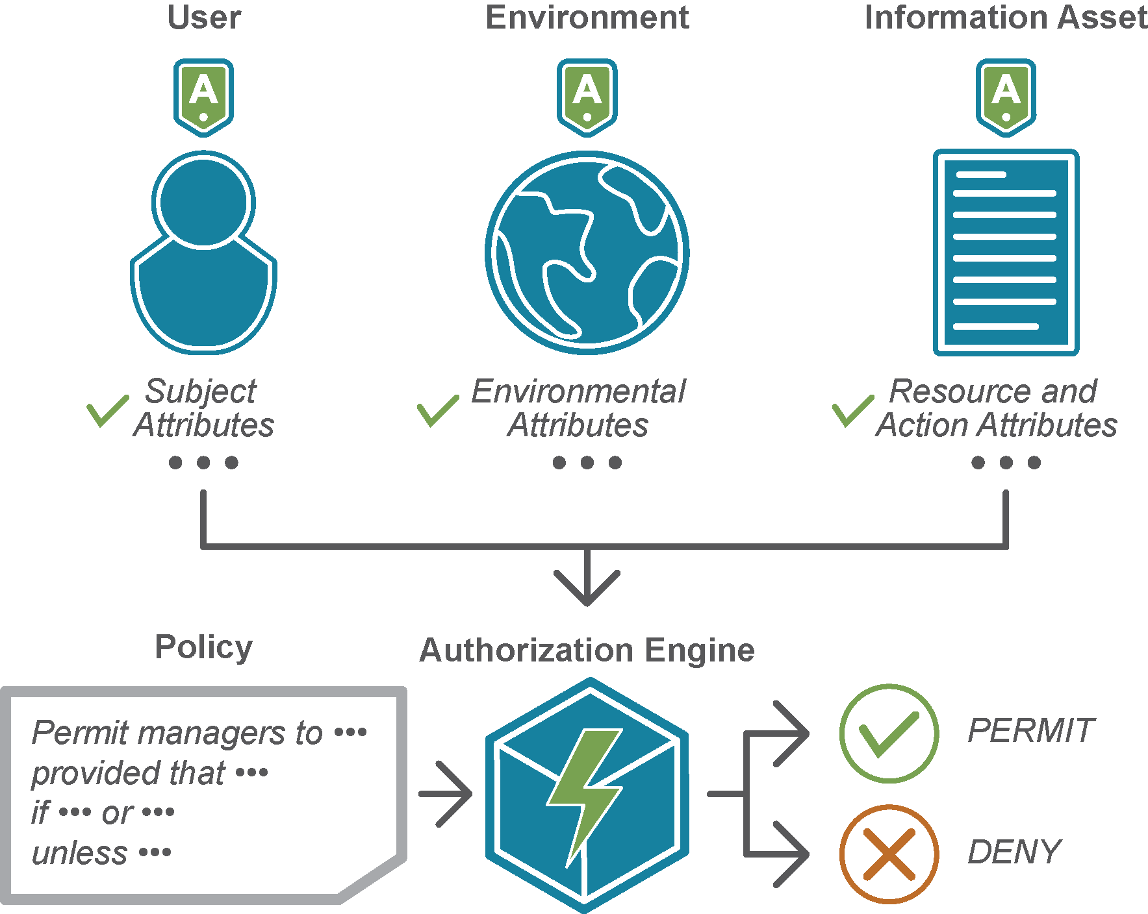
Attribute-based Access Control (ABAC)

Slide 15

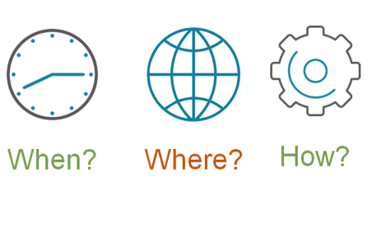

Attribute-Based Access Control (ABAC)
Notes:
https://www.axiomatics.com/blog/the-state-of-the-union-of-authorization/

Slide 16
ABAC Model: Attributes
Subject attributes
A subject is an active entity that access resources or change the system state
Resource attributes
A resource is the information asset to protect
Environment attributes
Describe the operational, technical, and environment or context in which the information access occurs
Attributes define the identity and characteristics of the subject
Resource have attributes that can be used to make access control decisions
e.g., Time of access, place of access and device used
(e.g. student can only get their transcript and not other student transcripts)
XACML "eXtensible Access Control Markup Language” is a standard that defines:
A declarative attribute-based access control policy language
An architecture to enforce and manage the policies
A processing model describing how to evaluate access requests according to the rules defined in policies.
Notes:
Can define authorizations that express conditions on properties of both the resource and the subject
A relatively recent development in access control technology is the attribute-based
access control (ABAC) model. An ABAC model can define authorizations that
express conditions on properties of both the resource and the subject. For example,
consider a configuration in which each resource has an attribute that identifies the
subject that created the resource. Then, a single access rule can specify the ownership
privilege for all the creators of every resource. The strength of the ABAC
approach is its flexibility and expressive power. [PLAT13] points out that the main
obstacle to its adoption in real systems has been concern about the performance
impact
of evaluating predicates on both resource and user properties for each
access. However, for applications such as cooperating Web services and cloud computing,
this increased performance cost is less noticeable because there is already a
relatively high performance cost for each access. Thus, Web services have been pioneering
technologies for implementing ABAC models, especially through the introduction
of the eXtensible Access Control Markup Language (XAMCL) [BEUC13],
and there is considerable interest in applying the ABAC model to cloud services
[IQBA12, YANG12].
A subject is an active entity that causes information to flow among objects or changes the system state
There are three key elements to an ABAC model: attributes, which are defined
for entities in a configuration; a policy model, which defines the ABAC policies; and
the architecture model, which applies to policies that enforce access control. We
examine these elements in turn.
Attributes are characteristics that define specific aspects of the subject, object, environment
conditions, and/or requested operations that are predefined and preassigned
by an authority. Attributes contain information that indicates the class of information
given by the attribute, a name, and a value (e.g., Class=HospitalRecordsAccess,
Name=PatientInformationAccess, Value=MFBusinessHoursOnly).
The following are the three types of attributes in the ABAC model:
• Subject attributes: A subject is an active entity (e.g., a user, an application, a
process, or a device) that causes information to flow among objects or changes
the system state. Each subject has associated attributes that define the identity
and characteristics of the subject. Such attributes may include the subject’s
identifier, name, organization, job title, and so on. A subject’s role can also be
viewed as an attribute.
• Object attributes: An object, also referred to as a resource , is a passive (in the
context of the given request) information system-related entity (e.g., devices,
files, records, tables, processes, programs, networks, domains) containing or
receiving information. As with subjects, objects have attributes that can be
leveraged to make access control decisions. A Microsoft Word document, for
example, may have attributes such as title, subject, date, and author. Object
attributes can often be extracted from the metadata of the object. In particular,
a variety of Web service metadata attributes may be relevant for access
control purposes, such as ownership, service taxonomy, or even Quality of
Service (QoS) attributes.
• Environment attributes: These attributes have so far been largely ignored in
most access control policies. They describe the operational, technical, and even
situational environment or context in which the information access occurs. For
example, attributes, such as current date and time, the current virus/hacker
activities, and the network’s security level (e.g., Internet vs. intranet), are not
associated with a particular subject nor a resource, but may nonetheless be
relevant in applying an access control policy.

Slide 17
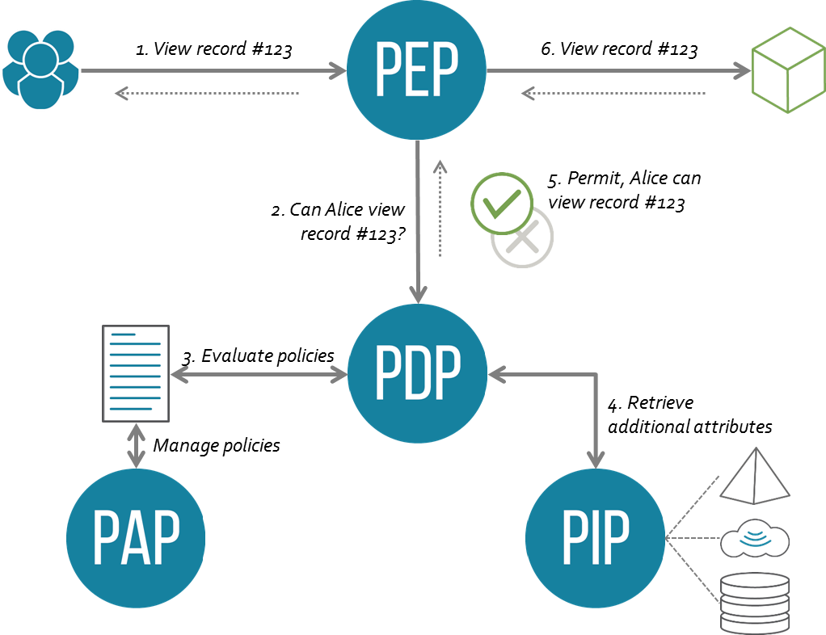
Architecture
PAP | Policy Administration Point | Point which manages access authorization policies
PDP | Policy Decision Point | Point which evaluates access requests against authorization policies before issuing access decisions
PEP | Policy Enforcement Point | Point which intercepts user's access request to a resource, makes a decision request to the PDP to obtain the access decision (i.e. access to the resource is approved or rejected), and acts on the received decision
PIP | Policy Information Point | The system entity that acts as a source of attribute values (i.e. a resource, subject, environment)
17

Slide 18
ABAC model
bool IsActionAllowed(subject, resource, action) {
permit = true
for each rule in rules {
Examines the rule condition using the attributes of subject and resource as well as the environment
If rule not meet then permit = false
}
return permit
}
Notes:
, and so could basically do anything

Slide 19
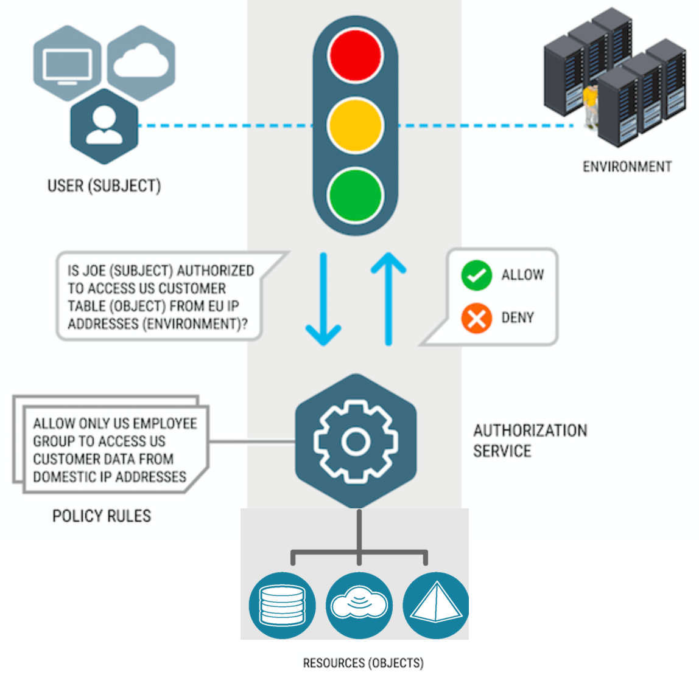
Scenario 1
19

Slide 20
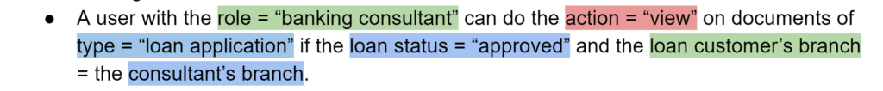
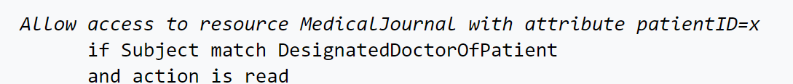
Scenario 2

Slide 21
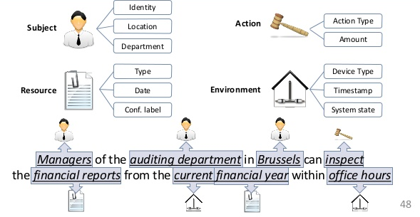
Scenario 3

Slide 22
Resources
NIST Digital Identity Guidelines
https://pages.nist.gov/800-63-3/
XAML
https://en.wikipedia.org/wiki/XACML
Notes:
Future:
- Risk-based login challenges
WebAuth
FIDO 2
U2F
https://auth0.com/blog/what-the-new-nist-guidelines-mean-for-authentication/
https://auth0.com/docs/multifactor-authentication
Open source password manager
http://www.keepassx.org/
Commercial password managers
https://www.pcmag.com/article2/0,2817,2407168,00.asp
Guide to Attribute Based Access Control (ABAC) Definition and Considerations
https://csrc.nist.gov/publications/detail/sp/800-162/final
OAuth 2
https://www.oauth.com/
Good resource to learn about JWT
https://jwt.io/
RBAC
https://www.npmjs.com/package/easy-rbac
OAuth 2.0 and OpenID Connect (in plain English)
https://www.youtube.com/watch?v=996OiexHze0
How Google is using OAuth?
https://www.youtube.com/watch?v=fxRXLbgX53A
Talk by Ryan Boyd
http://www.youtube.com/watch?v=YLHyeSuBspI
Good simple explanation
https://support.okta.com/help/Documentation/Knowledge_Article/Technical_Documentation/OAuth-and-Open-ID
Best https://www.youtube.com/watch?v=996OiexHze0
https://www.npmjs.com/package/rbac

